Slide 1
MedIA Group
Introduction
System
Training
Test
References
Skeletal Muscle Cell Segmentation Using Distributed Convolutional Neural Network
Fuyong Xing, Manish Sapkota, Fujun Liu
Medical Image Analysis (MedIA) Group
Final Presentation for Big Data,
April 20, 2015

Slide 2
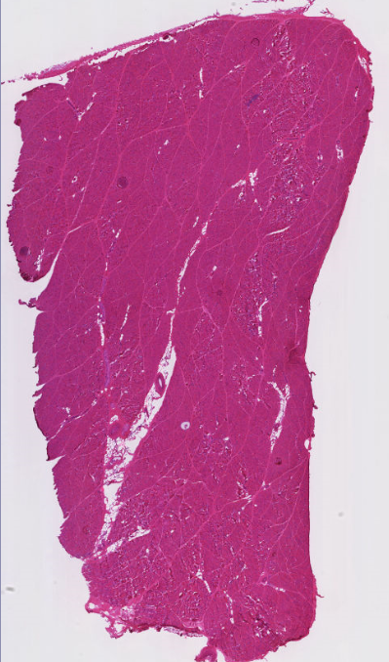
MedIA Group
Introduction
System
Training
Test
References
Background
There is agreement across the muscle biology community that muscle fiber area, are critical factors that determine the health of the muscle.
However, at this time, quantification is still a manual or, at best, a semi-automatic process. This process is labor intensive and time consuming and can be prone to errors, leading to high inter-observer variability.

Slide 3
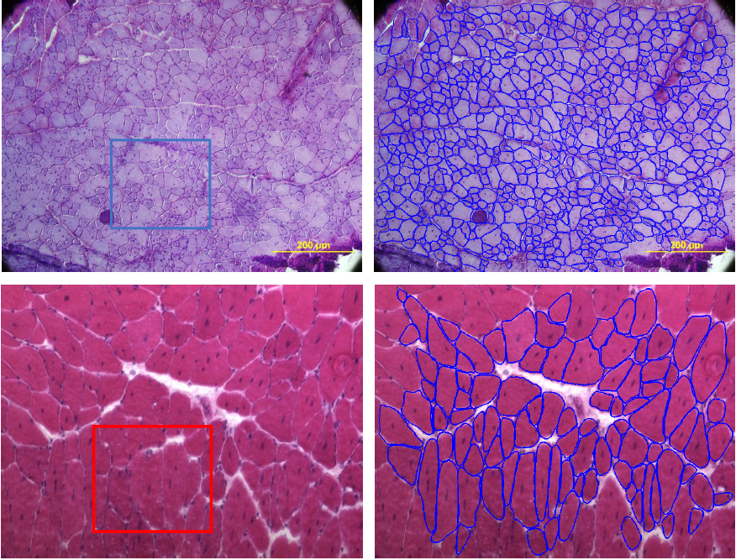
MedIA Group
Introduction
System
Training
Test
References
Challenges

Slide 4
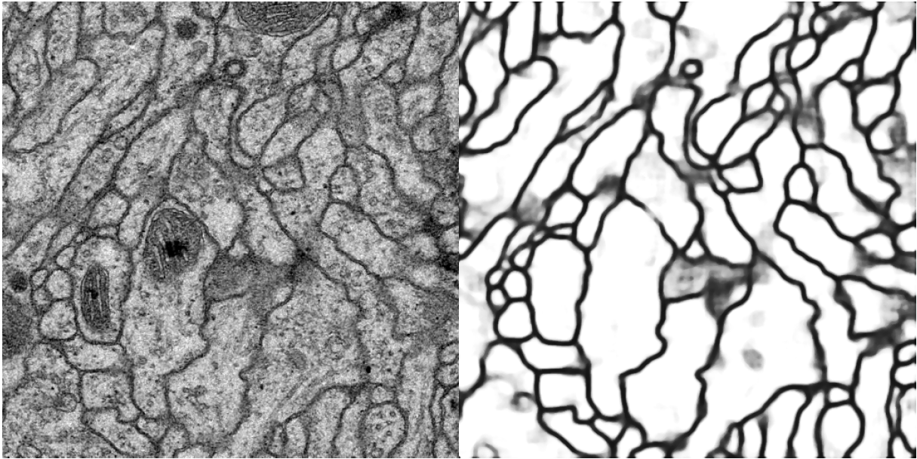
MedIA Group
Introduction
System
Training
Test
References
Related Work
Ciresan, Dan, et al. "Deep neural networks segment neuronal membranes in electron microscopy images." Advances in neural information processing systems. 2012.

Slide 5
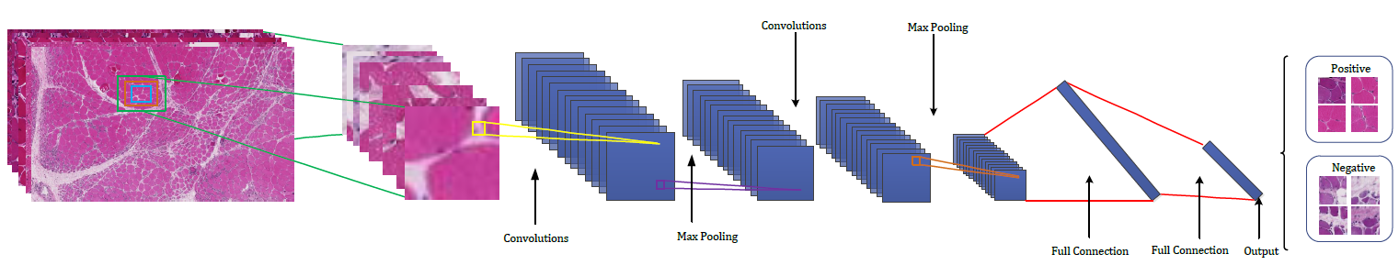
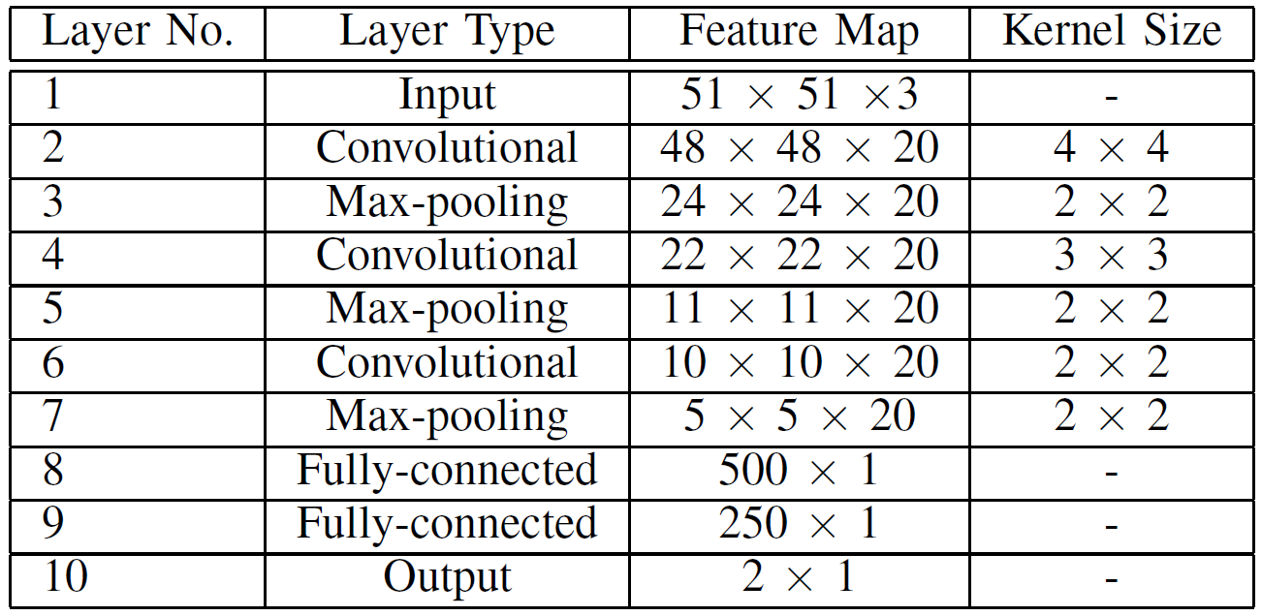
MedIA Group
Introduction
System
Training
Test
References
Deep Convolutional Neural Network (CNN) for Muscle Segmentation

Slide 6
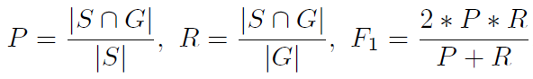
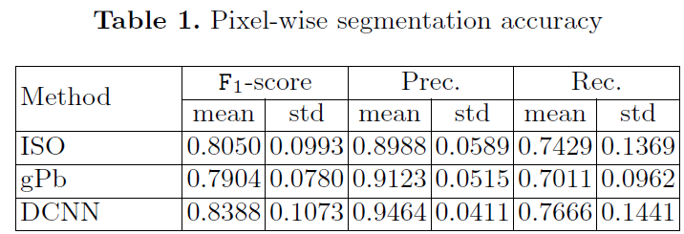
MedIA Group
Introduction
System
Training
Test
References
Evaluation
Metric: precision (P), recall (R) and F1 score

Slide 7
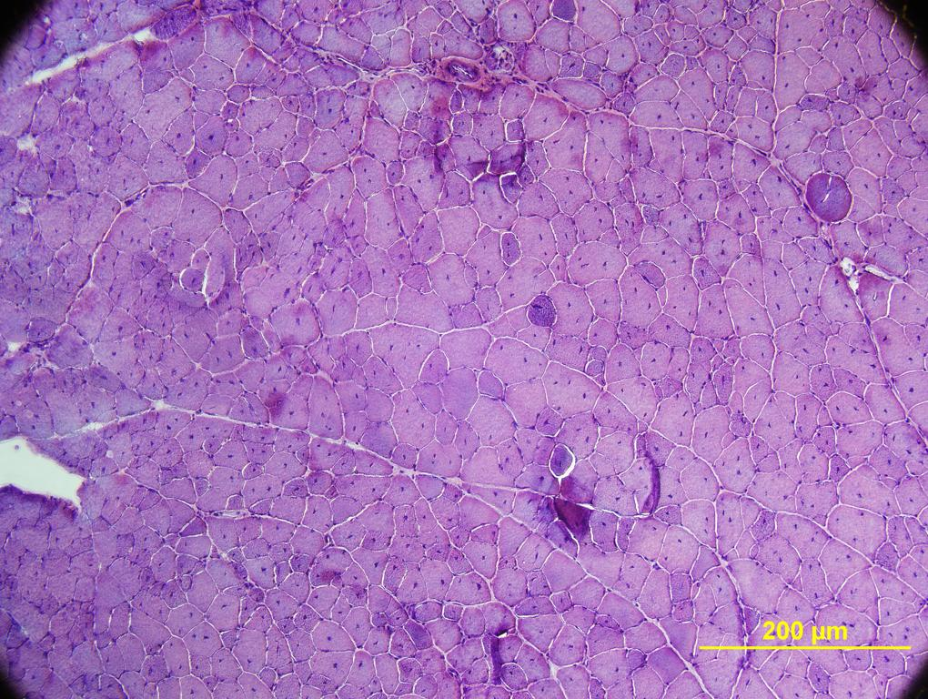
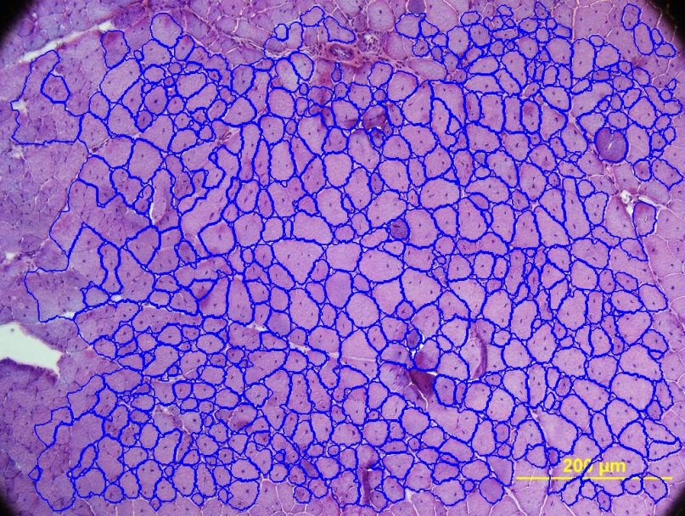
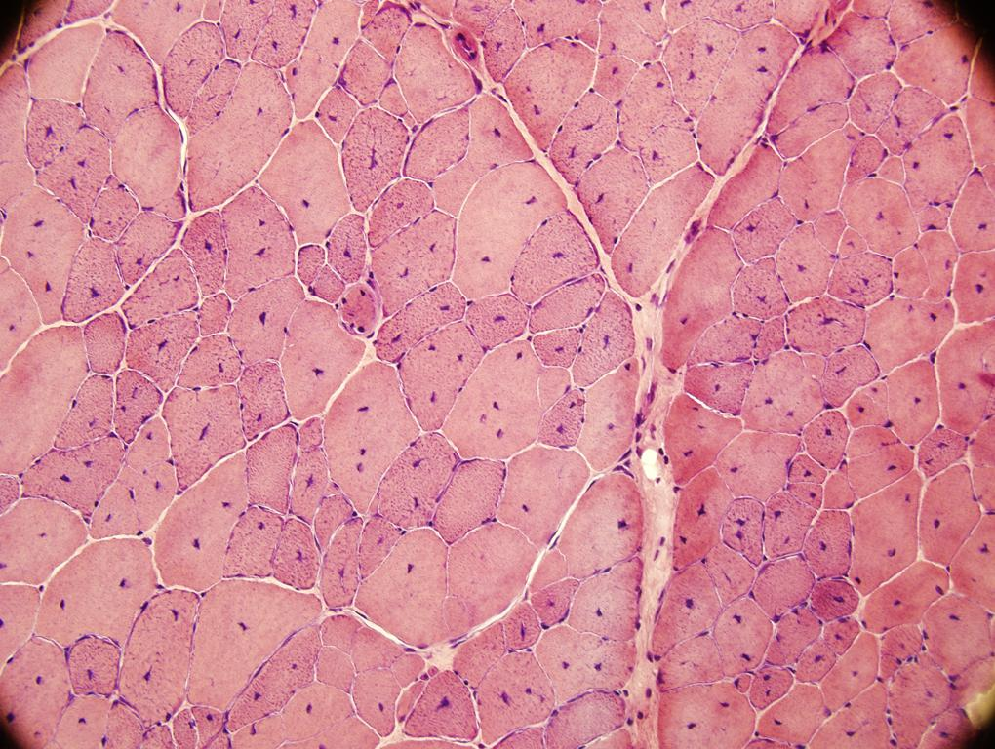
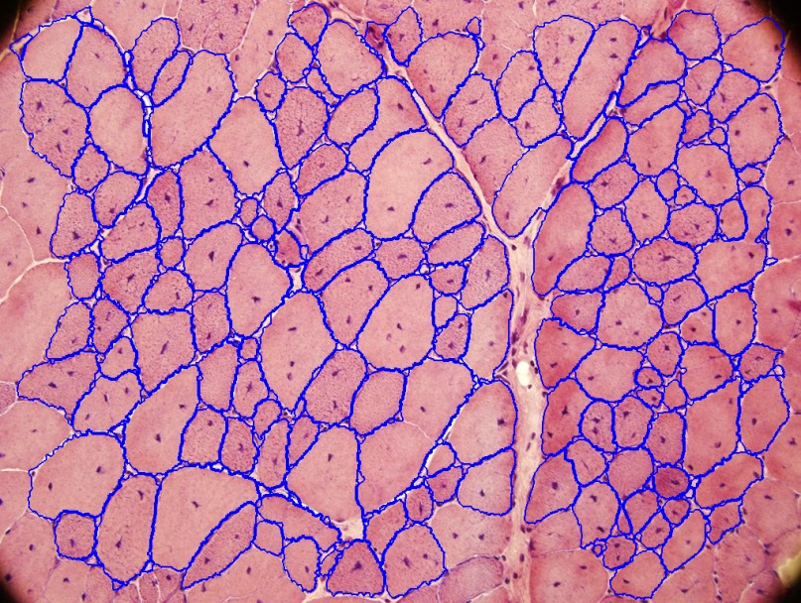
MedIA Group
Introduction
System
Training
Test
References
Sample Results

Slide 8
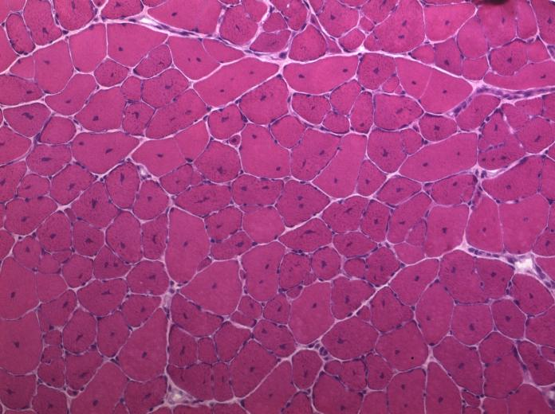
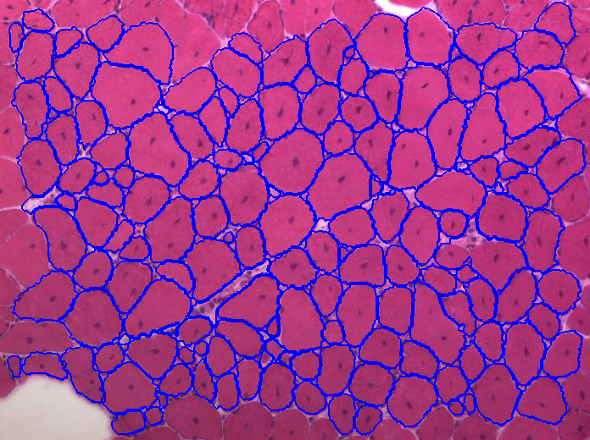
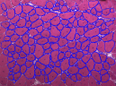
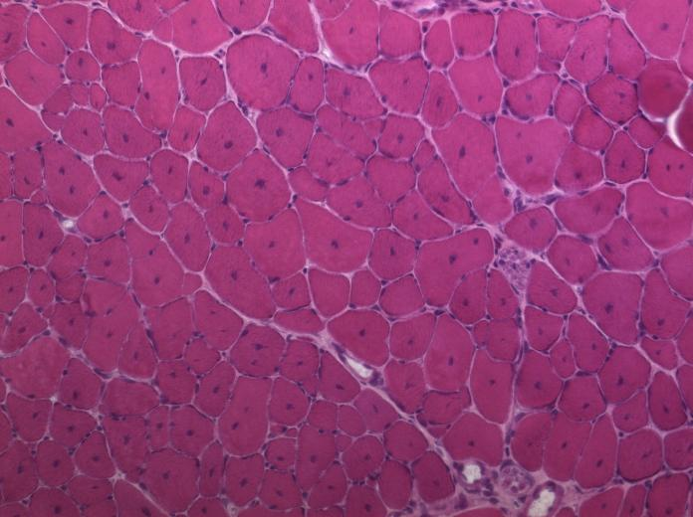
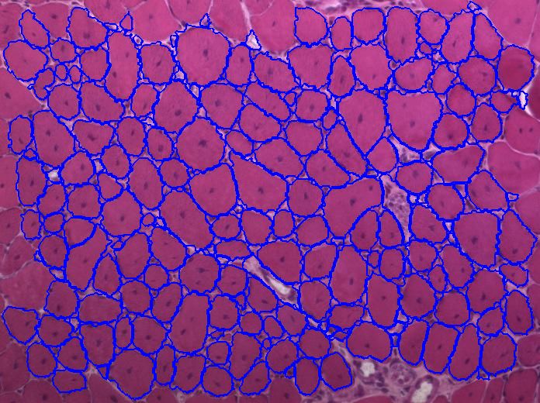
MedIA Group
Introduction
System
Training
Test
References

Slide 9
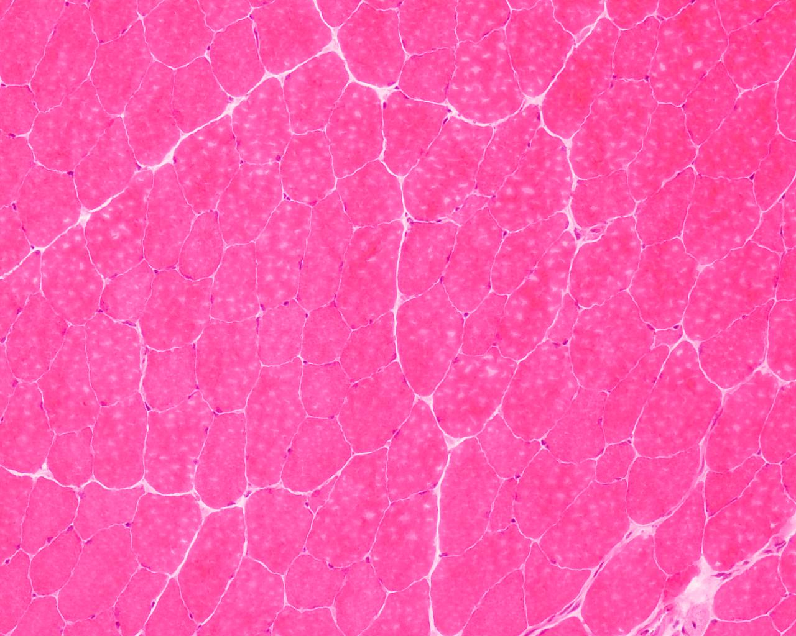
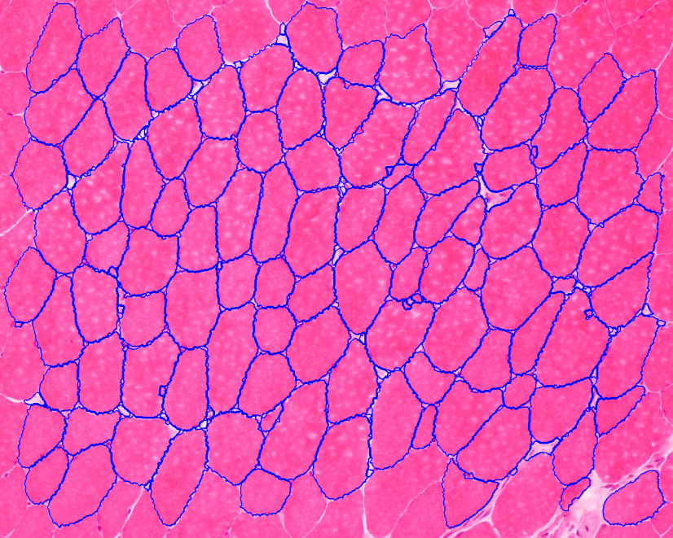
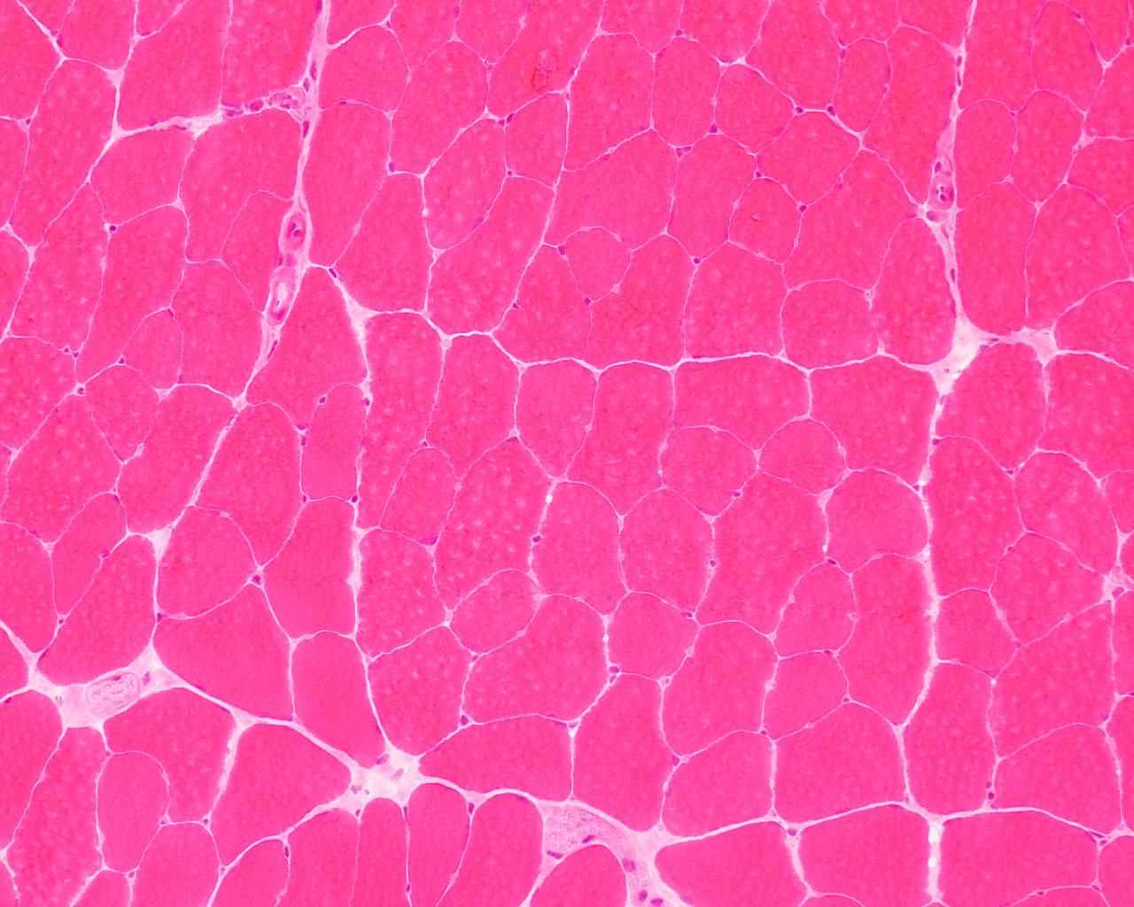
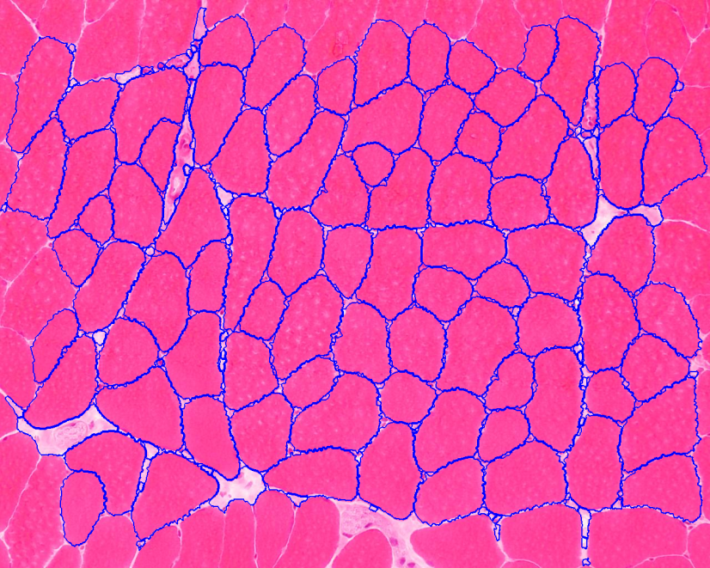
MedIA Group
Introduction
System
Training
Test
References

Slide 10
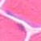
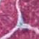
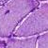
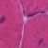

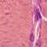
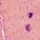
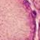

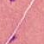
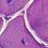
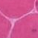
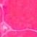
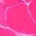


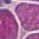

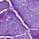
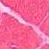






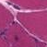
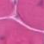
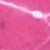

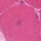
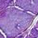


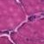
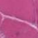
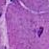
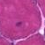
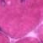
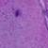
MedIA Group
Introduction
System
Training
Test
References
Training Images
Positive
Negative
In total, two million samples are used for training

Slide 11
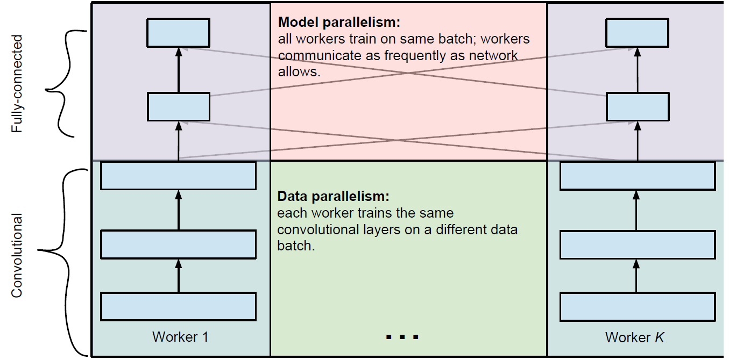
MedIA Group
Introduction
System
Training
Test
References
Distributed Training
Figure courtesy of Alex Krizhevsky

Slide 12
MedIA Group
Introduction
System
Training
Test
References
Distributed Training
S
Push and pull
Dev 0
Dev 1
Backed by parameter server
https://github.com/dmlc/cxxnet

Slide 13
MedIA Group
Introduction
System
Training
Test
References
Distributed Training
Parameter server
https://www.usenix.org/system/files/conference/osdi14/osdi14-paper-li_mu.pdf

Slide 14
MedIA Group
Introduction
System
Training
Test
References
Distributed Training
Parameter server
Push/Pull API provided that performs gradient update
asynchronously.
https://www.usenix.org/system/files/conference/osdi14/osdi14-paper-li_mu.pdf

Slide 15
MedIA Group
Introduction
System
Training
Test
References
Distributed Training
For our implementation
Distributed training on multiple CPU-cores and GPUs.

Slide 16
MedIA Group
Introduction
System
Training
Test
References
Distributed Training
Network trained on more than 2 million data
Architecture moderately complex
Non-distributed training takes about 8 hours on CPU

Slide 17
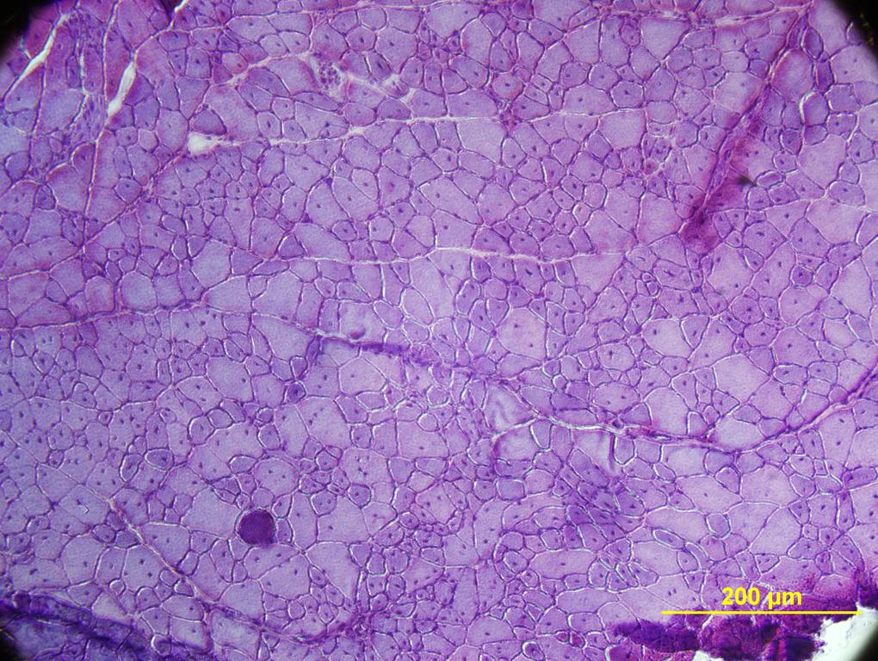
MedIA Group
Introduction
System
Training
Test
References
Test
Training
Test
Sliding window is a straightforward solution

Slide 18
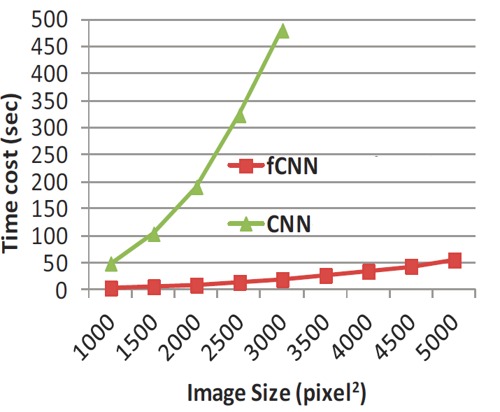
MedIA Group
Introduction
System
Training
Test
References
Sliding window DOES NOT SCALE

Slide 19
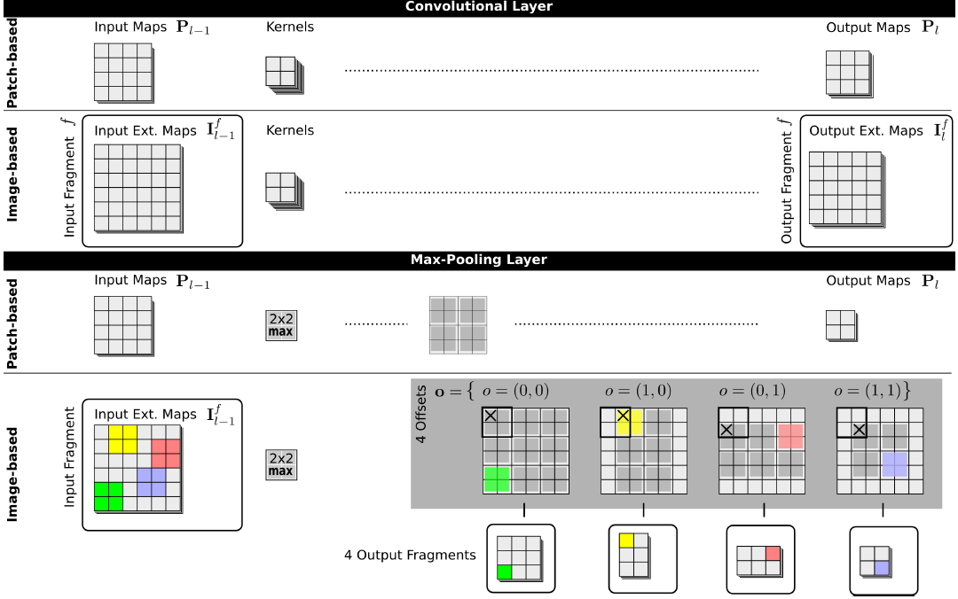
MedIA Group
Introduction
System
Training
Test
References
Fast Scanning

Slide 20

MedIA Group
Introduction
System
Training
Test
References
Super Fast Scanning
Parallel
Collect
Fast Scanning

Slide 21
MedIA Group
Introduction
System
Training
Test
References
Spark Implementation
import cnnfastscan # fast scanning module
divs = []
for ih in range(hDivs):
for iw in range(wDivs):
divs.append((ih, iw))
distdivs = sc.parallelize(divs, partitions).cache()
sub_edgemaps = distdivs.map(
lambda (ih,iw):cnnfastscan.get_sub_img(img/255.0, hDivs, wDivs, ih, iw, divsize, padsz)).map(
lambda ((ih, iw), sub_img):((ih, iw), cnnfastscan.predictImage(model, sub_img))).collect()
edgemap = cnnpredict.collect_subedgemaps(H0, W0, sub_edgemaps, hDivs, wDivs, divsize)

Slide 22

MedIA Group
Introduction
System
Training
Test
References
Fast Scanning

Slide 23

MedIA Group
Introduction
System
Training
Test
References
Distributed Experiment
Scaling the fast scanning
Distributed the patches level work in the image.
Tested on AWS for different patch size.

Slide 24
MedIA Group
Introduction
System
Training
Test
References
References
[1] Giusti A, Cireşan D C, Masci J, et al. Fast image scanning with deep max-pooling
convolutional neural networks. arXiv preprint arXiv:1302.1700, 2013.
[2] Ciresan D, Giusti A, Gambardella L M, et al. Deep neural networks segment neuronal membranes in electron microscopy images, Advances in neural information processing systems. 2012: 2843-2851.

Slide 25
MedIA Group
Introduction
System
Training
Test
References
Questions??

